Slide 1
Chronic Absenteeism Equity Profile
Amber Humm Brundage
abrundage@mail.usf.edu

Slide 2
Chronic Absenteeism (CA)
No standard definition
  Often based on total number of days missed
    Does not differentiate reasons for absences
      Includes: excused, unexcused and suspensions
Frequently defined as:
  Missing 10% or more of instructional days
  Missing 15 or more days of school per year
Important Differences -
  Truancy = unexcused absences (s. 1003.26(b), F.S.)
  Average Daily Attendance = how many students show up each day
  Chronic Absence = missing so much school for any reason that a
  student is academically at-risk - missing 10% or more of school
Notes:
Amber

Slide 3
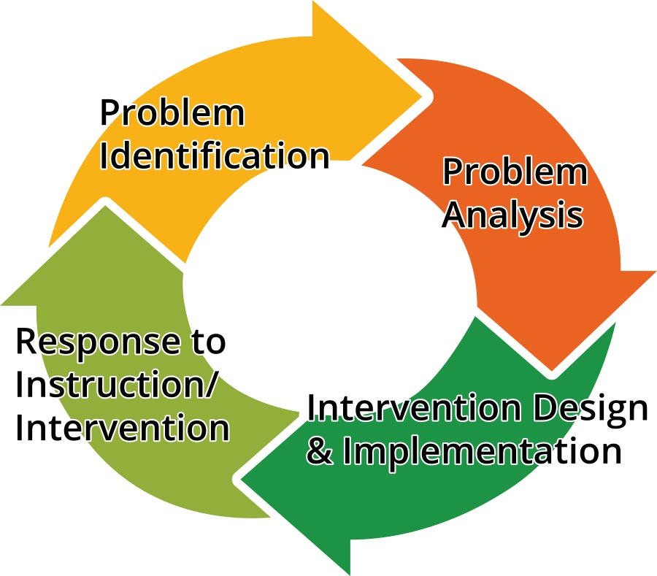
Problem Solving Chronic Absenteeism
Missing 10% or more of instructional days: (who & how many- disproportionality)
Interviews, Surveys, RCAs: (aggregate & individual)
Use attendance data/EWS to monitor effectiveness
Intervention based on reasons for absences
Notes:
Jose

Slide 4
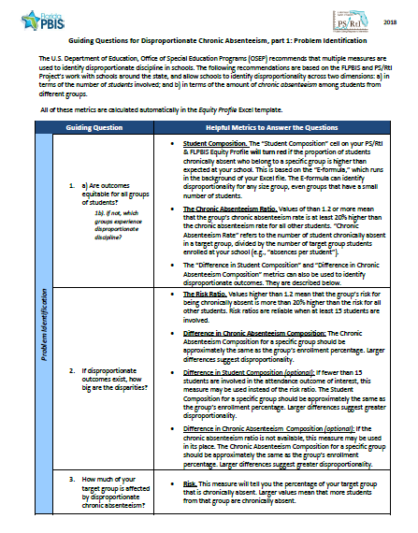
Guiding Questions- Problem Identification
Are outcomes equitable for all groups of students?
If not, how big are the disparities?
How much of the group is affected by disproportionate chronic absenteeism?

Slide 5
Data Elements
Number of students enrolled
  Overall & Subgroup
Total number of absences from the group (total instances of absences)
  Overall & Subgroup
Number of students in group with absences
  18+, 15+, 9+

Slide 6
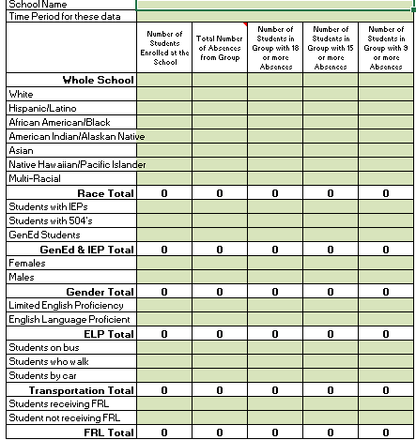
Data Calculator Chart
Notes:
Enter data into the instructions tab. All cells do not have to have data for calculator to work- enter the data for the groups and levels (18+, 15+ or 9+ absences) of interest.

Slide 7
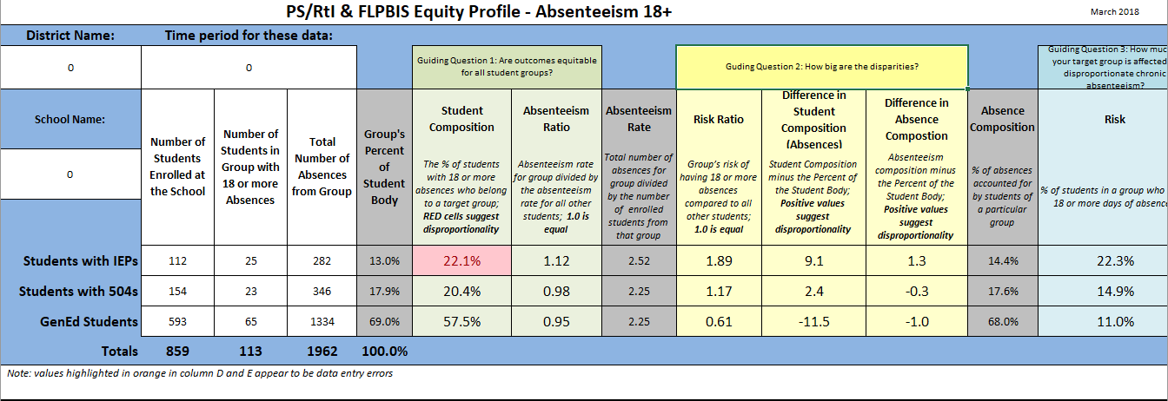
Equity Profile
Notes:
This is what a completed template would look like. Once the information in the first three fields was entered, everything from Groups Percent of Student Body to Risk appeared automatically.

Slide 8
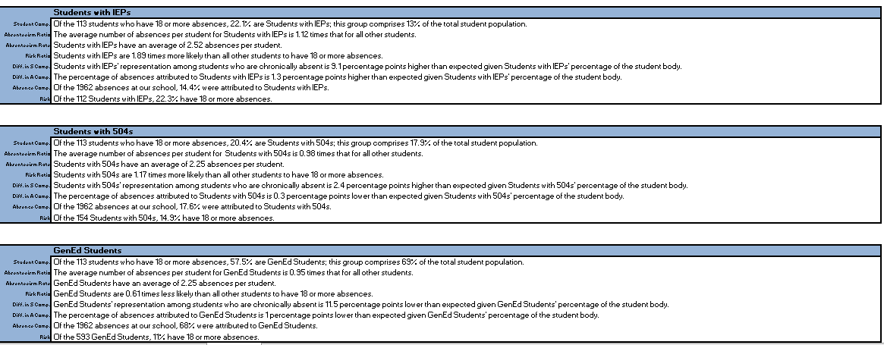
Metrics Table
Notes:
Below the table with all of the metrics, are written statements for each student group to help you interpret the results of the profile. Your school team can then review this information to determine if your implementation strategies are resulting in equitable outcomes.

Slide 9
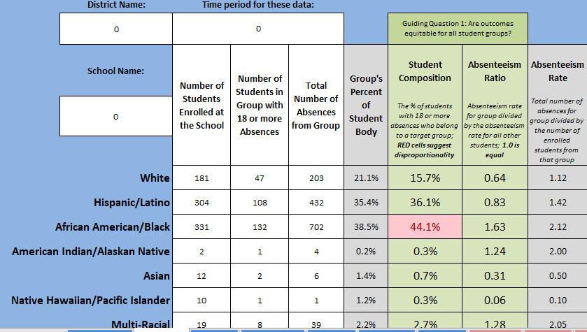
Q1: Are Outcomes Equitable for all Groups? 1
Method 1:
Student Composition cell will turn red
Method 2:
Ratios exceeding 1.3
Notes:
The gray columns are there for reference only. To determine if a group is over-represented in discipline, look at the student composition or absenteeism ratio. Student Composition cells will turn red if the racial group makes up too high of a proportion of the students who are chronically absent.
You may also look at the Absenteeism ratio. If the ratio is much higher than 1.0 (anywhere from 1.3 or higher), then the group’s absenteeism rate is noticeably higher than the absenteeism rate for all other students.

Slide 10
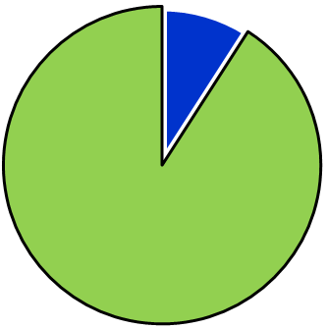
Q1: Are outcomes equitable for all groups?
Method 1: Student Composition
Disproportionality based on the number of students who are chronically absent
  Background formula provides a cut-off for the student composition value
  If the student composition is too high, the cell will turn red
African American students who are chronically absent
All other students who are chronically absent

Slide 11
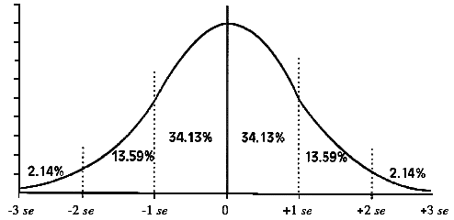
Q1: Are outcomes equitable for all groups?
Student Composition & the E-formula
A background formula checks to see if the student composition for a racial group is within “expected” boundaries (standard error from the mean)
  Considers the total number of chronically absent students at your school, and the size of the demographic group
Student Composition value: This is OK – it falls within an expected range.
(cell stays green)
This is not.
(cell turns red)
Notes:
If you have a student composition value that falls outside of that range, the Equity Profile will flag that group as having disproportionate outcomes, and the group’s student composition cell will turn red.

Slide 12
Why the e-Formula?
Can be used with very small groups
Is not impacted by students who have multiple absences
Reduces the likelihood that a group will be falsely identified as having disproportionate outcomes
Recommended by OSEP’s IDEA Center
Notes:
Finally, the e-formula was one of several measures recommended by the U.S. Department of Education’s IDEA center, so there is good standing for using the metric with educational outcome data.

Slide 13
Q1: Are Outcomes Equitable for all Groups?
Method 1:
Student Composition cell will turn red
Method 2:
Ratios exceeding 1.3
Notes:
The gray columns are there for reference only. To determine if a group is over-represented in discipline, look at the student composition or absenteeism ratio. Student Composition cells will turn red if the racial group makes up too high of a proportion of the students who are chronically absent.
You may also look at the Absenteeism ratio. If the ratio is much higher than 1.0 (anywhere from 1.3 or higher), then the group’s absenteeism rate is noticeably higher than the absenteeism rate for all other students.

Slide 14









Q1: Are outcomes equitable for all groups?
Method 2: Chronic Absenteeism Ratio
Disproportionality based on the amount of absences (e.g., number of instances)
  Values greater than 1.0 mean the group has a higher absenteeism rate than all other students
  Considers the number of absences among students in that demographic group, and the total number of students enrolled in that demographic group
$$÷$$
$$÷$$
Number of Absences for Target Group Divided by Target Group Enrollment
Number of Absences for All Others’ Divided by All Others’ Enrollment

Slide 15
Interpreting the Chronic Absenteeism Ratio
Chronic Absenteeism Ratio Value | Rates for Chronic Absenteeism
1.0 | Equal
1.25 | 25% Higher
1.50 | 50% Higher
2.00 | Two Times Higher
2.50 | Two and a Half Times Higher
3.00 | Three Times Higher
> 3.00 | Yikes.
Notes:
An Absenteeism Ratio of 1.0 is ideal, because it means that the rates for your target and comparison group are equal. Whenever the chronic absenteeism ratio is higher than 1.0, it means that the target group has a higher chronic absenteeism rate than all other students. With attendance data, a Chronic Absenteeism Ratio greater than 1 is important because it means that the group has a relatively higher rate for missed instructional time. Chronic Absenteeism ratios that are less than one are less important, because it means that the group’s chronic absenteeism rate is lower than the rates of all other students.
Chronic Absenteeism ratios are interpreted by reading the numbers to the right of the decimal as “percent higher,” and the number to the left of the decimal as “times.” For example, a chronic absenteeism ratio of 1.25 is interpreted as a group having a 25% higher chronic absenteeism rate than the comparison group. When the ratio reaches 2.0 or higher, you would say that the target group has a “two times” higher chronic absenteeism rate than the comparison group, or a “three times” higher rate, and so on.

Slide 16
Q1: Are Outcomes Equitable for all Groups? 2
Method 1:
Student Composition cell will turn red
Method 2:
Ratios exceeding 1.3
Notes:
The gray columns are there for reference only. To determine if a group is over-represented in discipline, look at the student composition or absenteeism ratio. Student Composition cells will turn red if the racial group makes up too high of a proportion of the students who are chronically absent.
You may also look at the Absenteeism ratio. If the ratio is much higher than 1.0 (anywhere from 1.3 or higher), then the group’s absenteeism rate is noticeably higher than the absenteeism rate for all other students.

Slide 17
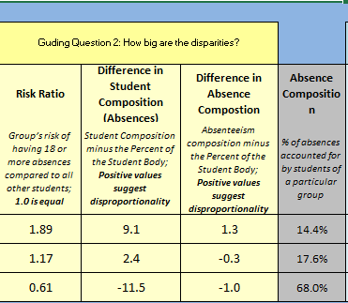
How big are the disparities?
Risk Ratio
Difference in Student Composition
Difference in Chronic Absenteeism Composition
Notes:
The next metric we’ll talk about is the risk ratio, which is a good summary measure that describes one group’s risk for chronic absenteeism compared to the risk for all other students. It can help you answer the question, “How big are the disparities?”.
The Difference in Student Composition is an optional metric used to address how big the disparities are in your school. It is often used when the target group is comprised of smaller numbers of students, or to communicate levels of disparities in a way that is easy for stakeholders to understand.
The Chronic Absenteeism composition and difference in Chronic Absenteeism composition metrics are located right next to each other on the Equity Profile. The Chronic Absenteeism composition is listed as a reference, and because it is the basis for calculating the difference in Chronic Absenteeism composition, but it’s not central to being able to answer the question of how large the discrepancies are for different groups of students. That is the reason the chronic absenteeism composition is greyed out in the profile.

Slide 18
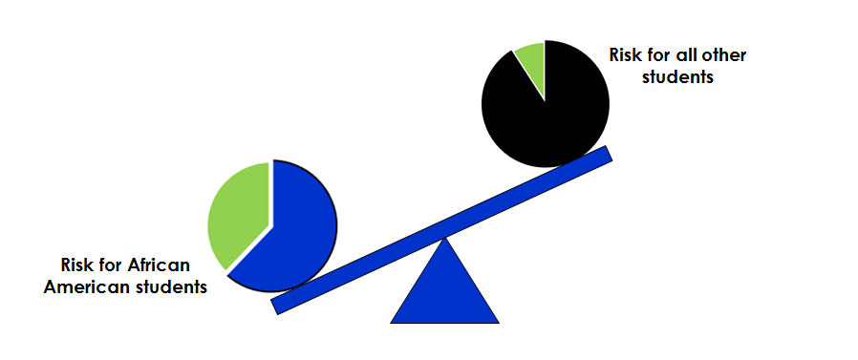
Disparities, Method 1
Q2: How big are the disparities?
Method #1: The Risk Ratio
The risk of one group compared to the risk of all other students
  Difficult to use with small numbers of students
  1.0 is ideal, larger numbers suggest larger disparities
Notes:
With the risk ratio, we’re hoping that the risk for different groups of students will be equal, which is represented by a value of 1 point zero. The risk ratio measures the number of students who were chronically absent (based on definition of 18+, 15+ or 9+ days), which means that it is not impacted by students who have multiple absences.
When you look at a risk ratio value in the Equity Profile, the value will represent that group’s risk of being chronically absent compared to the risk for all other students. This allows you to calculate a risk ratio for any group that received the consequence you’re studying. In other words, when you review the risk ratio for African American students, it will represent the risk for an African American student to be chronically absent compared to the combined risk of students who are Hispanic, students who are White, students who are multi-racial, and so on.

Slide 19
Interpreting the Risk Ratio
Risk Ratio Value | Level of Disproportionality
1.0 | Equal
1.25 | 25% Higher Risk
1.50 | 50% Higher Risk
2.00 | Two Times Higher Risk
2.50 | Two and a Half Times Higher Risk
3.00 | Three Times Higher Risk
> 3.00 | Yikes.
Risk Ratios higher than 7 are frequently a result of fewer than 10 students in either the target or comparison groups.
The group’s outcomes are still disproportionate, but the size of the risk ratio may overemphasize the scope of the problem.
Notes:
A risk ratio of 1.0 is ideal, as it means that the risk for your target and comparison group is equal. Whenever the risk ratio is higher than 1.0, it means that the target group has a higher risk than the comparison group. With attendance data, a risk ratio greater than 1 is important because it represents a higher risk for a poor outcome. Risk ratios that are less than zero are not important, because it means that the group is at a lower risk than all other students for a poor outcome.
Risk ratios are interpreted by reading the numbers to the right of the decimal as “percent higher,” and the number to the left of the decimal as “times.” For example, a risk ratio of 1.25 is interpreted as a group having a 25% higher risk than the comparison group. When the ratio reaches 2.0 or higher, you would say that the target group has a “two times” higher risk than the comparison group, or a “three and a half times” higher risk, and so on.
The take-home message for the risk ratio is this: “Values that are much higher than 1.0 suggest a higher risk for the target group.” If you run into a risk ratio that is higher than 7.0, check to see whether there are at least 10 students reflected in the target and in the comparison groups. If there’s not at least 10 students, look at a different metric to get a better sense of the group’s representation in the outcome of concern.

Slide 20
Equity Profile 1
Notes:
This is what a completed template would look like. Once the information in the first three fields was entered, everything from column F to column N appeared automatically. The Risk ratio of 1.89 for SWD can be interpreted as 89% greater risk for SWD of having 18+ absences than other students.

Slide 21
Q2: How big are the disparities?
Method #2: Difference in Student Composition (OPTIONAL)
The difference between a group’s percentage of the school enrollment and the group’s percentage of students who are chronically absent
  If the difference results in a positive value, this suggests disproportionality
Students Chronically Absent
Students Enrolled
Notes:
When looking at the difference in student composition, you will be comparing a target group’s representation among students who are chronically absent to the target group’s overall representation across the entire student body. We would expect that the target group’s representation among students who are chronically absent would be about the same as their representation in the school’s enrollment.

Slide 22
Calculating Difference in Student Composition
Our example: African American students
Target Group’s Student Composition
75% of students who are chronically absent
Target Group’s Percent of Student Body
33% of the student body
  African American students are over-represented among students who are chronically absent.
Difference in Student Composition
42
Notes:
This results in a difference of 42 percentage points, indicating that African American students are greatly over-represented among the chronically absent.

Slide 23
Equity Profile 2
Notes:
There is a difference of 9 percentage points between SWD percentage of chronically absent (22.1) and percentage of SWD in population (13.0). Positive values suggest disproportionality among SWD. Same for students with 504 plans.

Slide 24
Q2: How big are the disparities?
Method #3: Difference in Chronic Absenteeism Composition (OPTIONAL)
The Chronic Absenteeism Composition for a specific group should be approximately the same as the group’s enrollment percentage
  If the difference results in a positive value, this suggests disproportionality
Target group’s percentage of chronically absent
Target group’s percent of students Enrolled
Notes:
When looking at the difference in chronic absenteeism composition, you will be comparing a target group’s absences to the target group’s overall representation across the entire student body. We would expect that the target group’s share of absences would be about the same as their representation in the school’s enrollment. If the target group’s share of absences is greater than their representation in the student body, the difference in chronic absenteeism composition will be positive, which means that the group is over-represented.

Slide 25
Calculating Chronic Absenteeism Composition
Chronically Absent African American students
All Chronically Absent
The number of students do not matter to this metric
Notes:
To calculate the difference in chronic absenteeism composition, you must first find the Chronic Absenteeism Composition for your target group.

Slide 26
Calculating Difference in Chronically Absent Composition
Our example: African American students
Target Group’s Absenteeism Composition
62% of absences
Target Group’s Percent of Student Body
33% of the student body
  African American students are over-represented in terms of the amount of the number of absences they have
Difference in Chronic Absenteeism Composition
29
Notes:
This results in a difference of 29 percentage points, indicating that African American students are greatly over-represented in the amount of absences they have.

Slide 27
Equity Profile 3
Notes:
SWD account for 14.4% of absences, but only 13.0% of population = 1.3 percentage difference suggesting disproportionality

Slide 28
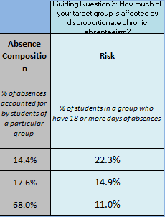
Q3: How much of your target group is affected?
Risk
  Percentage of students in the target group chronically absent

Slide 29
How much of your target group is affected by chronic absenteeism?
Method #1: Risk
The percentage of a group that is affected
African American students who are chronically absent
All African American students enrolled in the school
Notes:
Simply put, “risk” is the percentage of students of a particular group who are chronically absent). It measures students who meet the definition of being chronically absent (18+, 15+, 9+), so the metric is not impacted by students who have multiple absences.

Slide 30
Equity Profile 4
Notes:
22.3 % of SWD have 18+ absences as compared with 14.9% of students with 504s and 11% of GenEd students.

Slide 31
Problem Solving Chronic Absenteeism- Next Steps
Missing 10% or more of instructional days: (who & how many- disproportionality)
Interviews, Surveys, RCAs: (aggregate & individual)
Use attendance data/EWS to monitor effectiveness
Intervention based on reasons for absences
Notes:
Jose

Slide 32

Questions

Slide 33

Contact Information
Amber Brundage
  abrundage@mail.usf.edu
Sara Moulton
  saramoulton@usf.edu
Therese Sandomierski
  tsandomiersk@usf.edu
RCA Survey & RCA(s) Reports
http://www.floridarti.usf.edu/resources/topic/chronic_absenteeism/index.html
  Facebook: flpsrti
  Twitter: @flpsrti
Notes:
Pl

